Slide 1
Relationships between tectonic environments and deposits of gold in Western U.S.A displayed through Random Forest and SVM
Jacinda Chou, Amir khwan Haniff Mohd Nasir and Ashesh Dahal

Slide 2
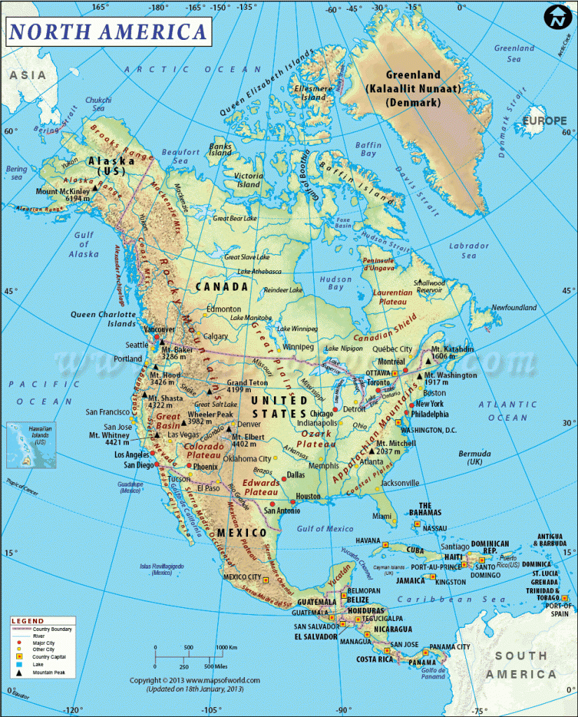

Slide 3
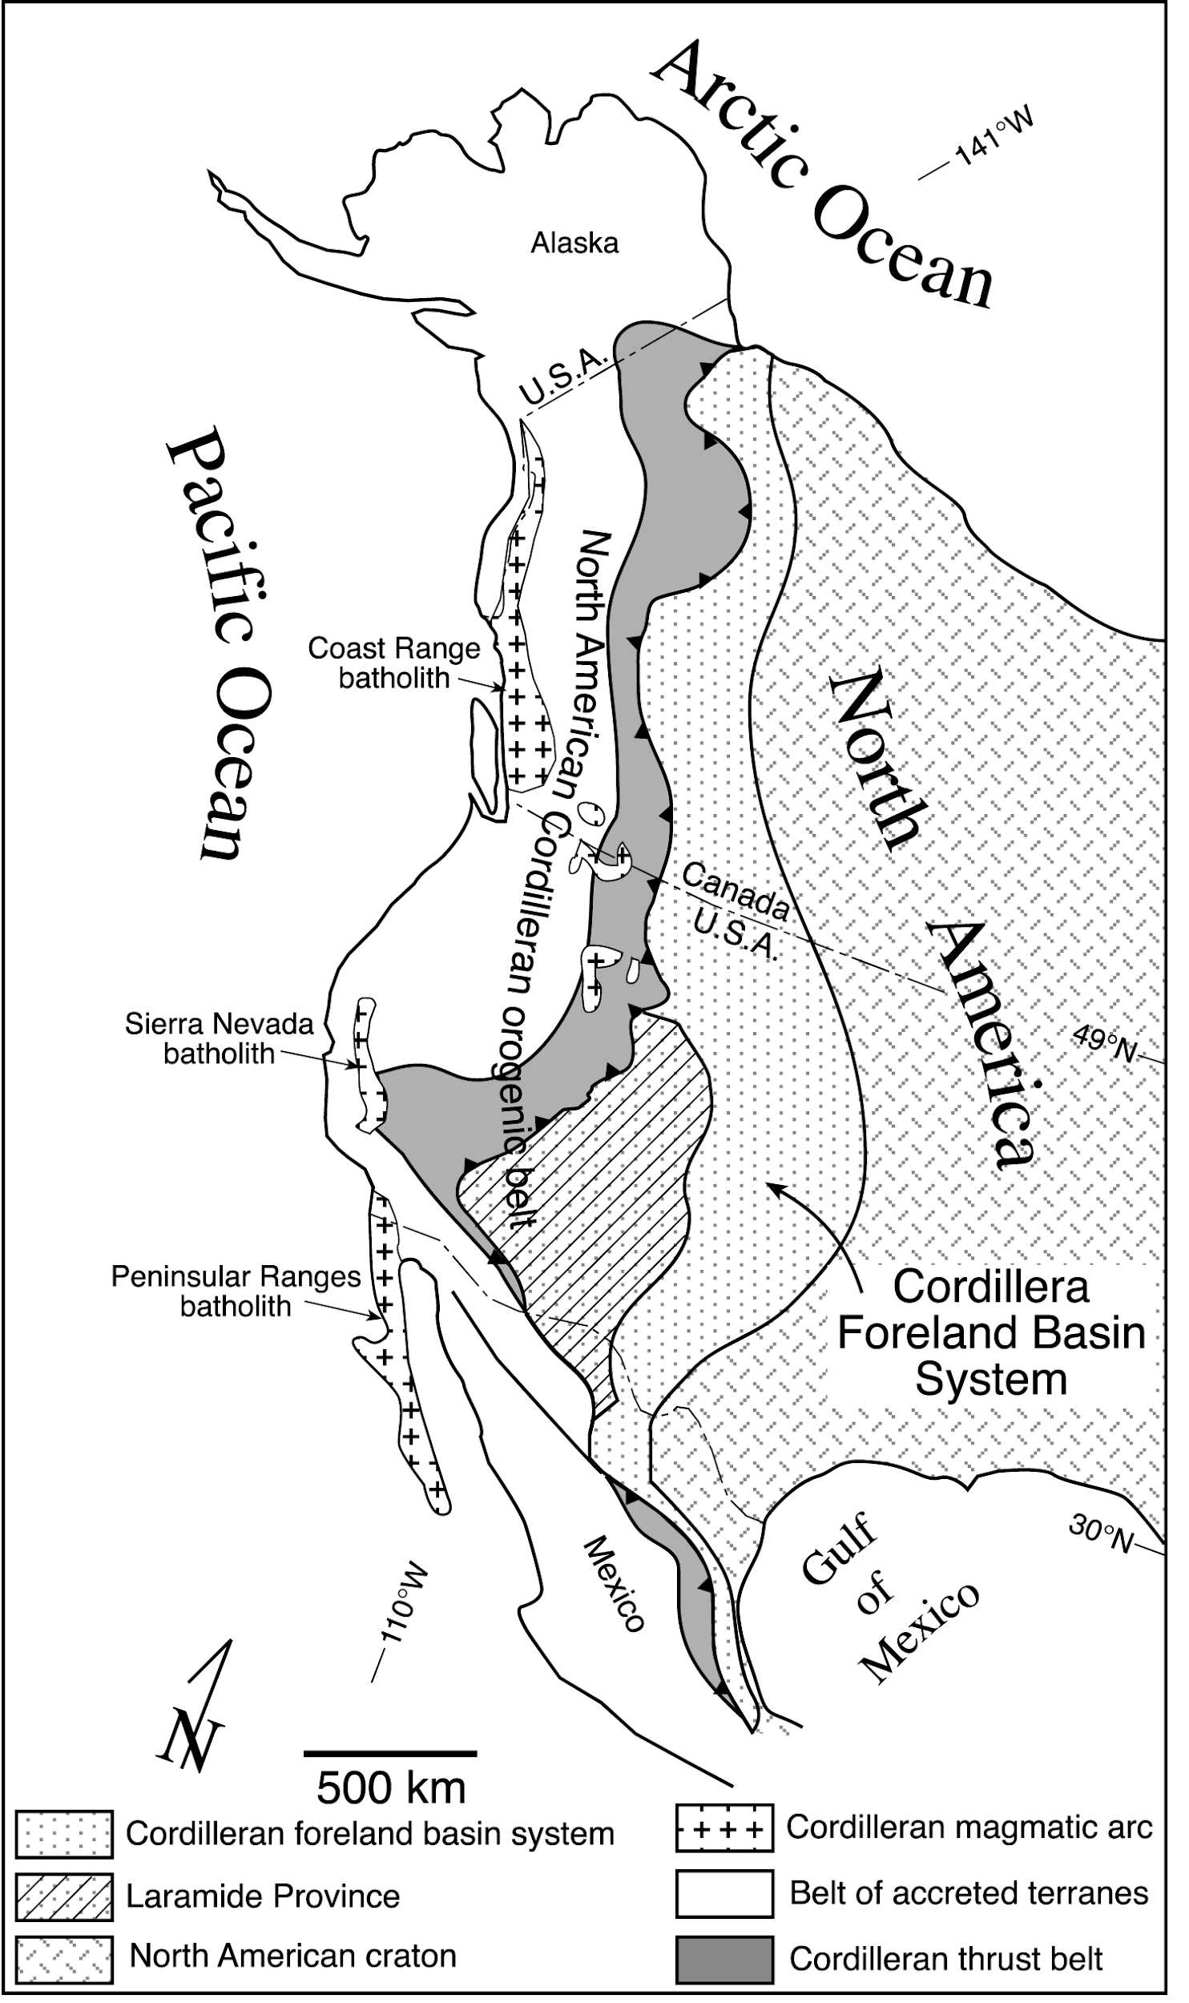
Cordilleran orogenic belt
Extends laterally to about 6000 kilometers (From Mexico to Canada)
Approximately around 50 Ma, tectonic activity from the orogenic belt created the Laramide Rocky Mountains
Often used as an example for typical subduction related mountain building processes

Slide 4
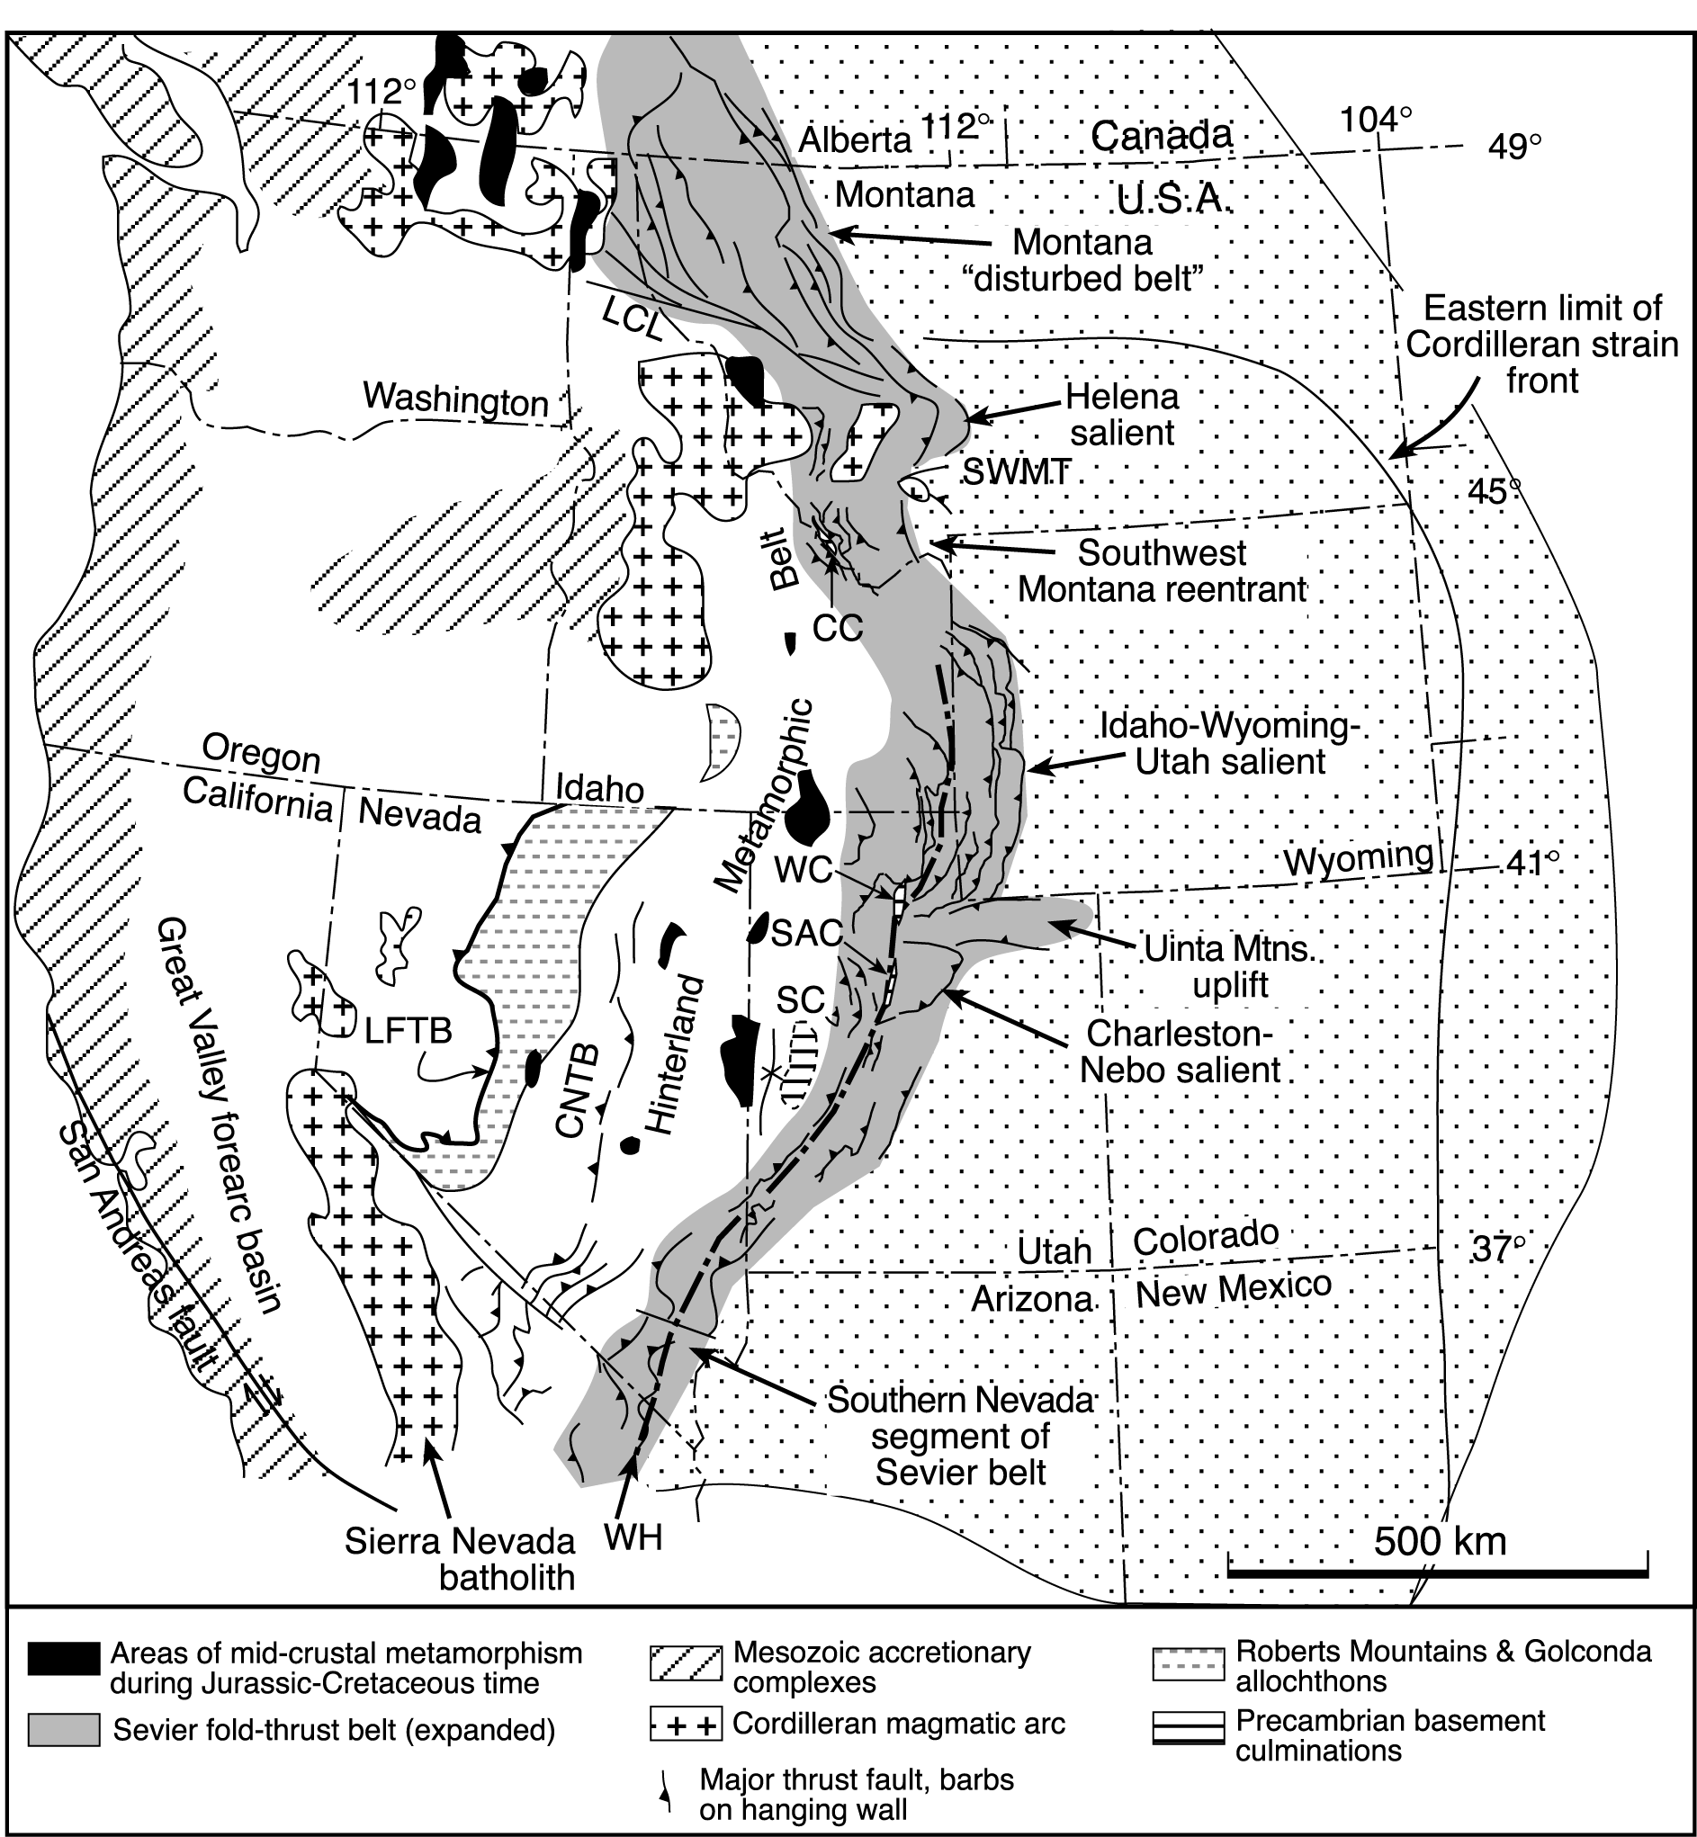
San Andreas fault
Second Tectonic event in the western coast of U.S.A.
Occurred approximately around 30 Ma.
Right - Lateral Strike Slip Fault
No more subduction processes occuring past this point.

Slide 5
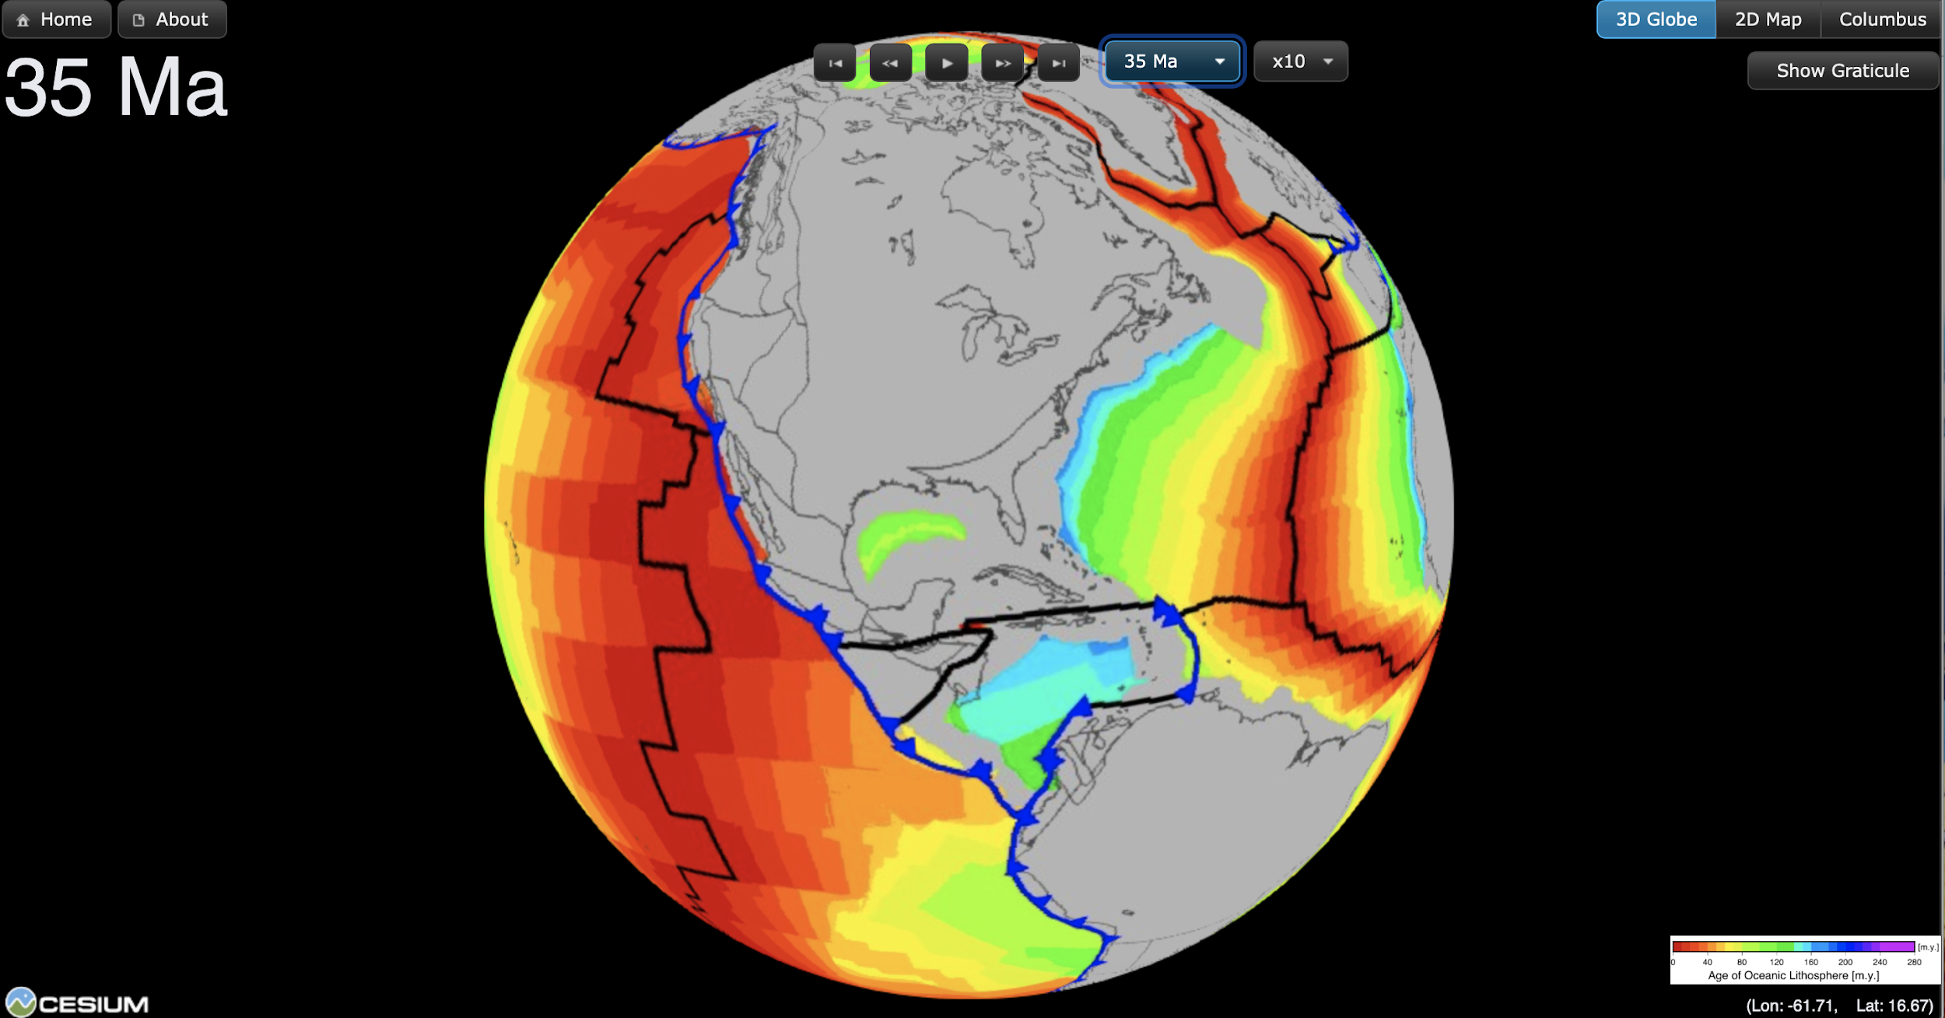

Slide 6
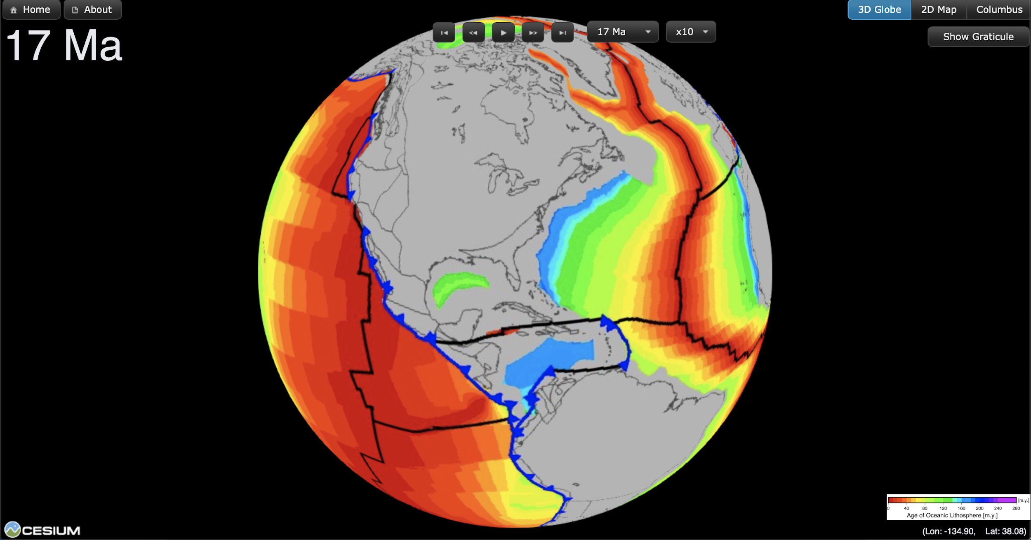

Slide 7
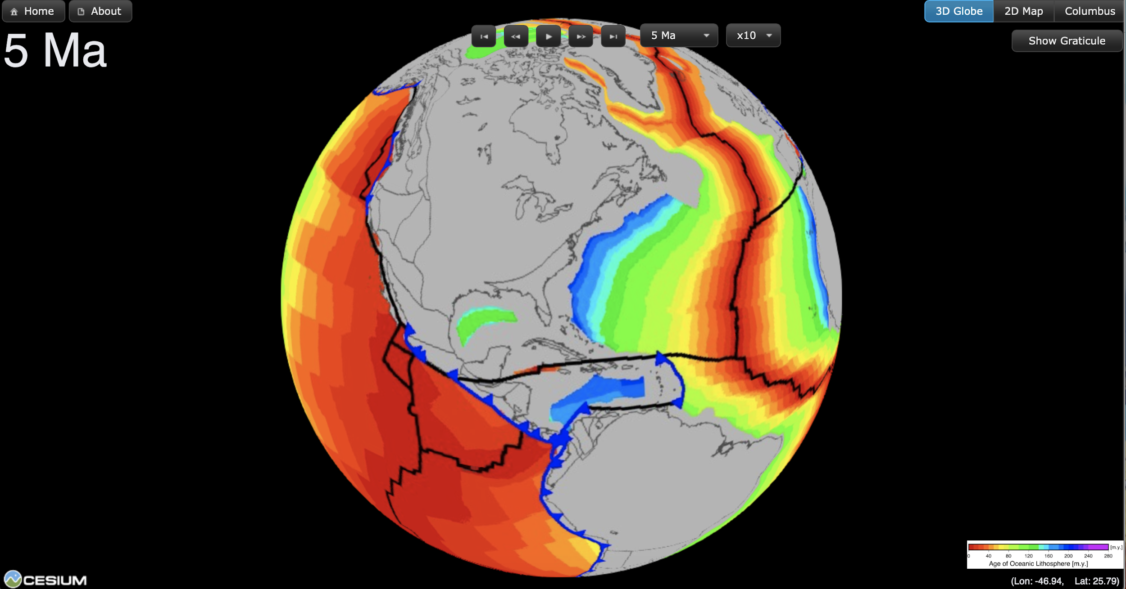
Now that we know a bit more
Let’s watch the video and view the process over time
http://portal.gplates.org/cesium/?view=AgeGrid

Slide 8
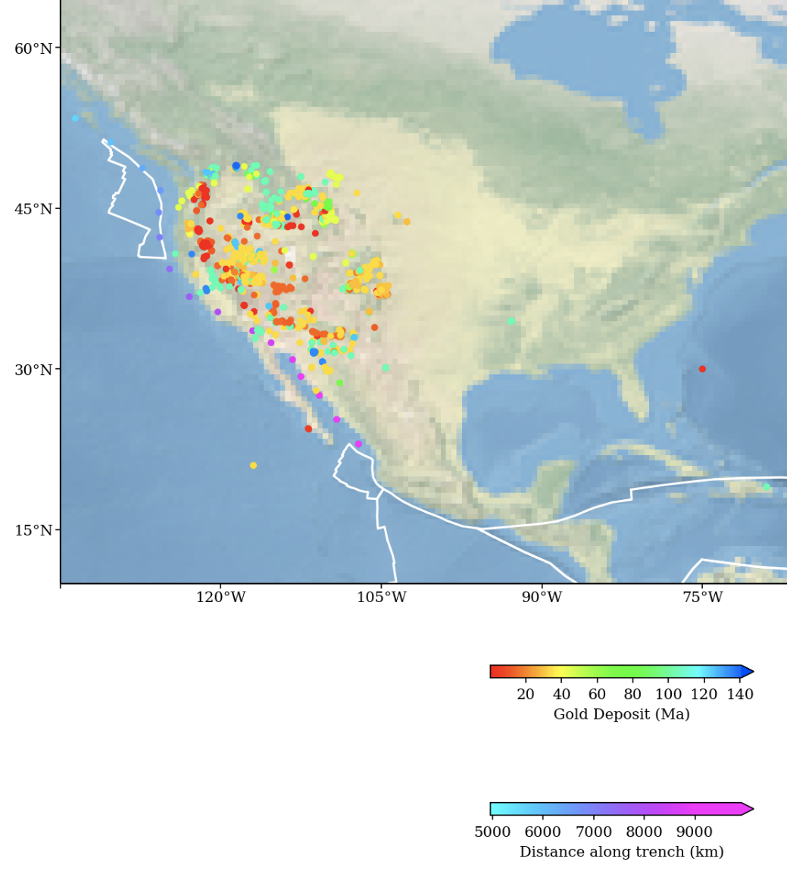
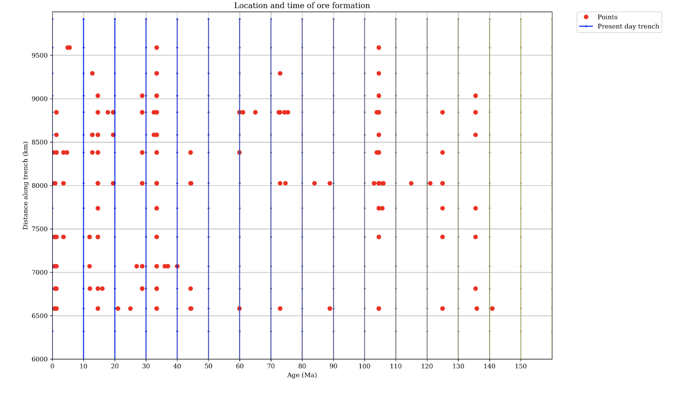
Cross-examination of Age related deposits

Slide 9
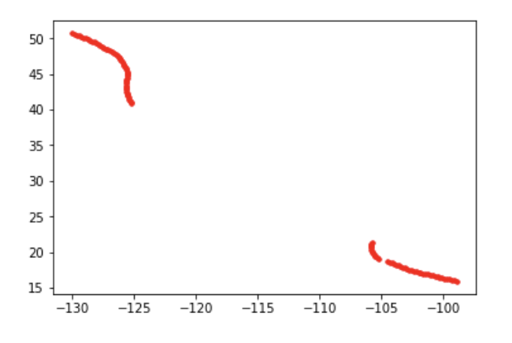

Python Method
Pulling subduction zone point for North America from kinematic file ~ Muller_convergence/subStats_0.csv
Plate ID = 101
(source: Earthbyte group)
No subduction zone!
Causing empty data in the array
Latitude

Slide 10
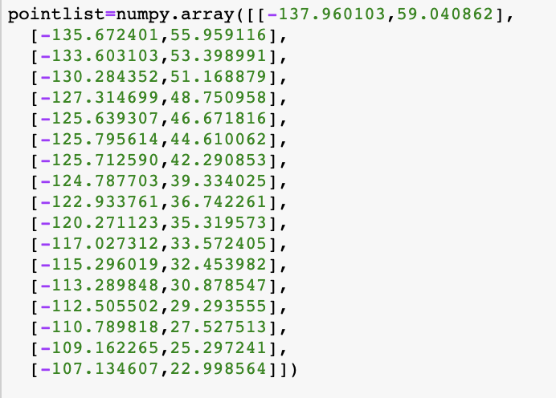
Subduction zone point
Manually input the subduction data along the current margin
We have to do this or else it is going to cause problem when running the machine learning ‘notebook’

Slide 11
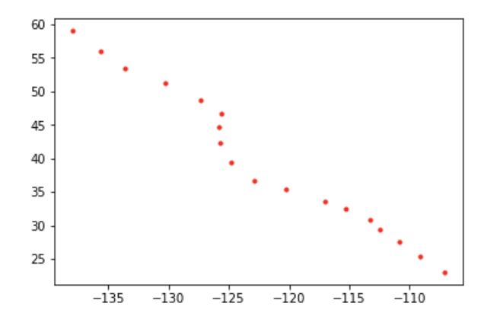
IT’S FIXED!
But not really...

Slide 12
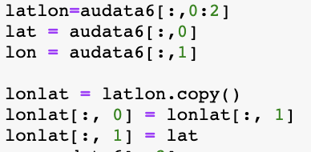
Reading the data from txt file
The txt file of gold deposits is in format of :
Latitude, Longitude
But we are expecting :
Longitude, Latitude
So we have to swap their columns!

Slide 13
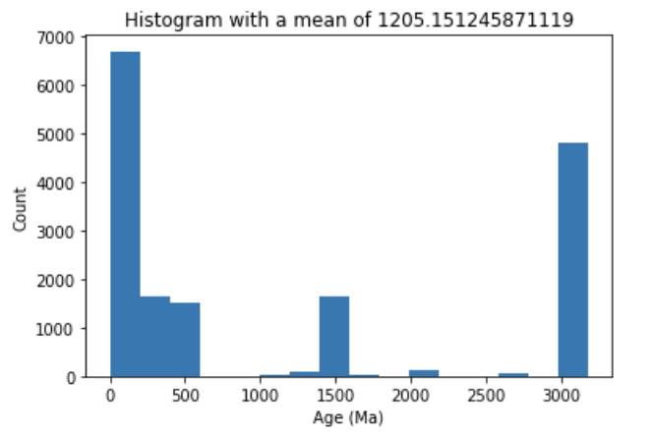
The data is too broad (A LOT!)
Over 16000!
We start by restricting the age from 0 Ma to 150 Ma
Removed the unnecessary data for our research
Histogram of gold deposits count in North America with respect to age

Slide 14
Machine Learning
Data wrangling
Reconstructing the geographical location of the data by ‘coregister’ the kinematic (pickle files) that associated with ore deposit at that time in that location
Put in a format that scikit.learn environment can read
Data partitioning
Splitted into ‘training’ and ‘testing’ points
For training purpose by using the classifiers to later be tested with testing data for prediction
To determine which parameters are related to deposition and non-deposition

Slide 15

Random Forest
Train the data set on many random decision trees
Use “majority voting” to determine which parameters are important for prediction

Slide 16
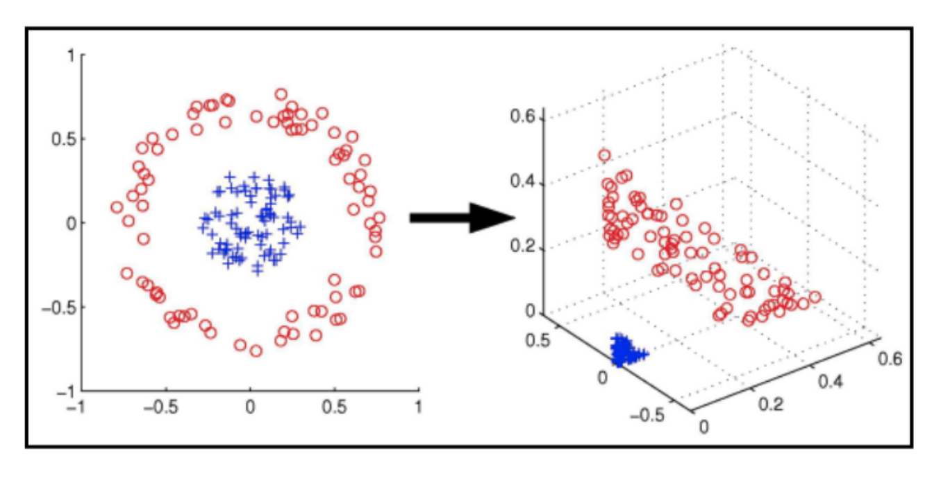
Support Vector Machine
Impossible to separate the ore deposits and non-deposits with a line
Using ‘kernel’ trick to separate the data set
Separate using hyperplane in 3D

Slide 17
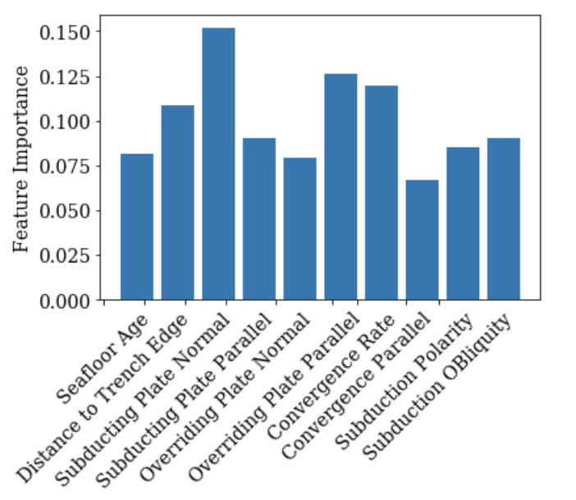
Optimised Rf Parameters
From a total of 20 parameters, Random forest was able to test and train the relationships between the parameters and the deposit data.
The 4 optimised parameters for North American tectonic setting are distance to trench age, subducting plate normal velocity, overriding plate parallel velocity and Convergence normal rate.

Slide 18
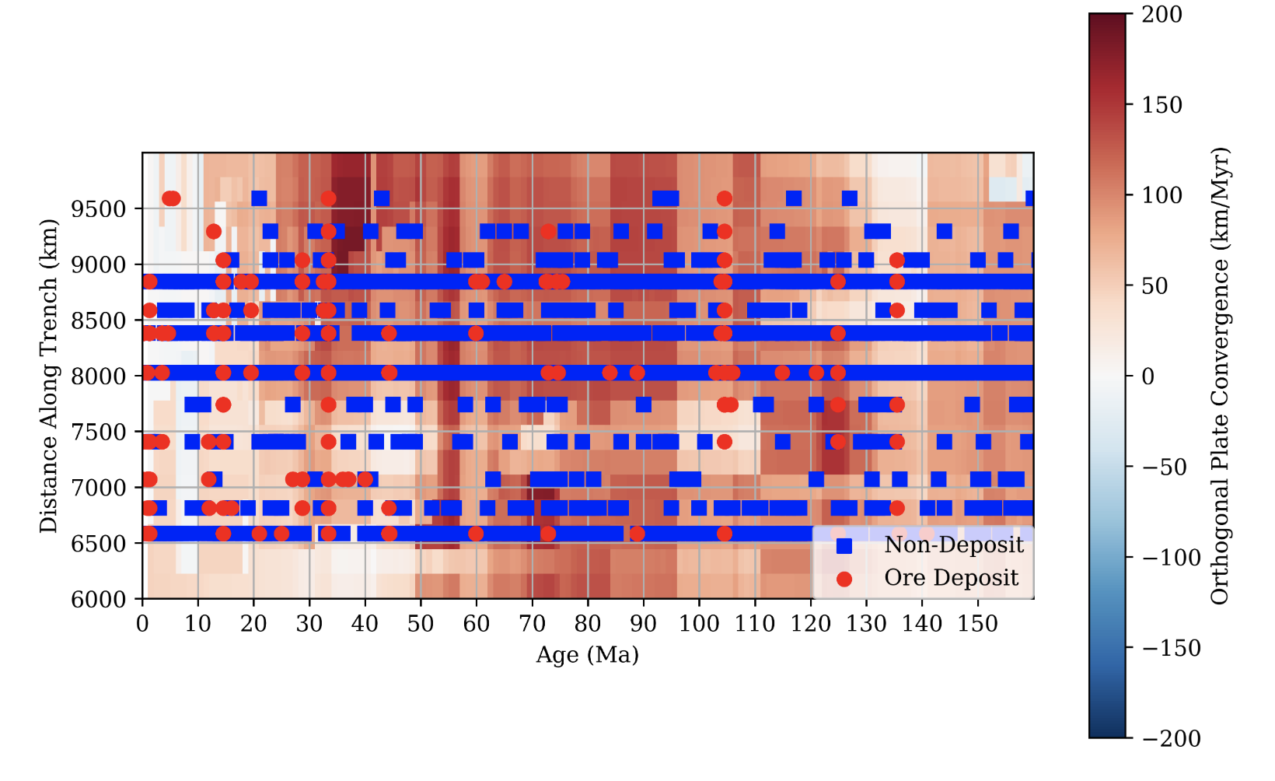
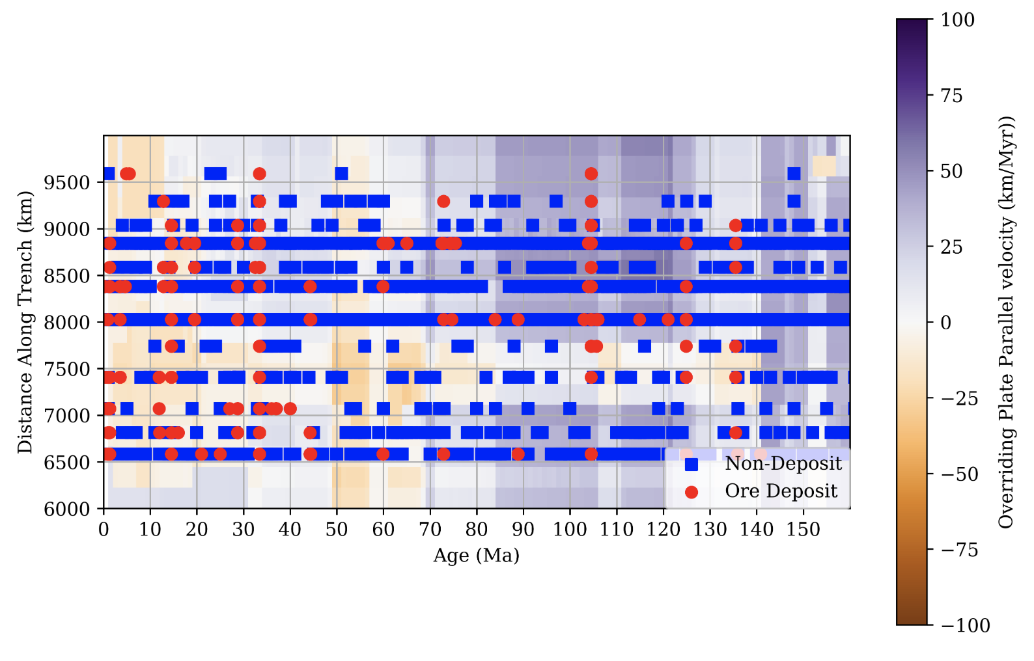
Relationship between parameters and gold deposits
Orthogonal Plate Convergence rate (km/Myr)
Overriding Plate Parallel velocity (km/Myr)

Slide 19
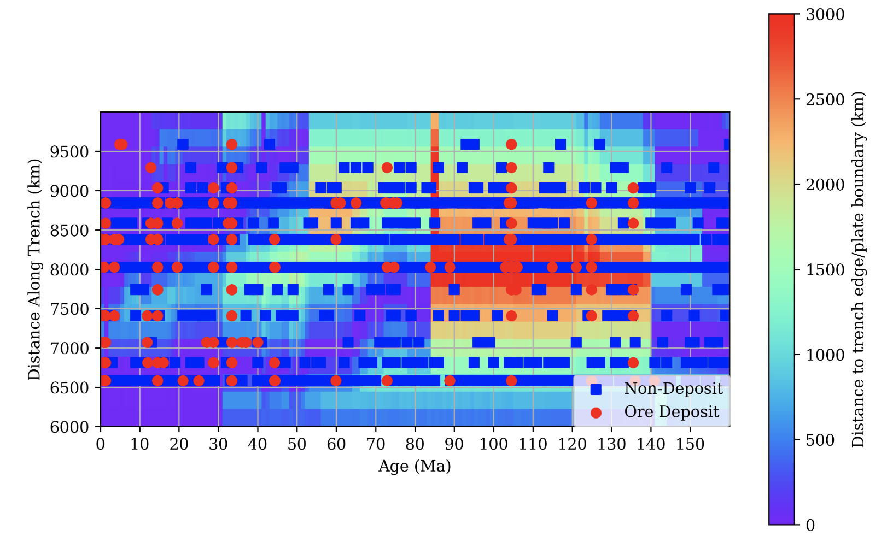
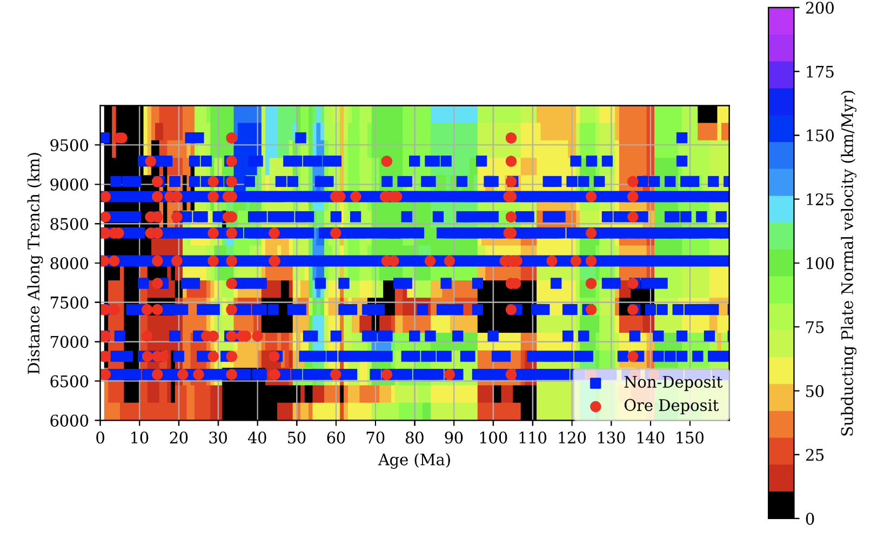
Relationship between parameters and gold deposits
Distance to trench edge / plate boundary (km)
Subducting Plate Normal velocity (km/Myr)

Slide 20
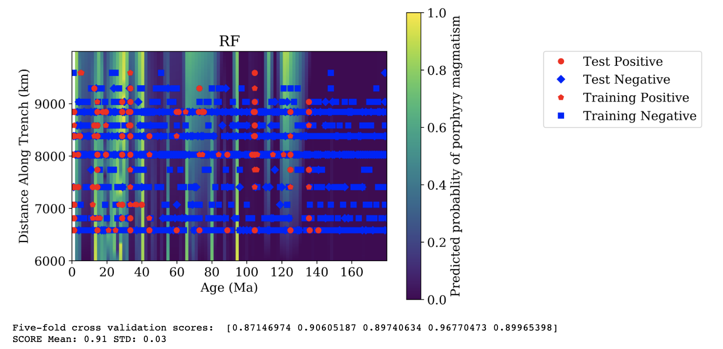
Random Forest testing and training system

Slide 21
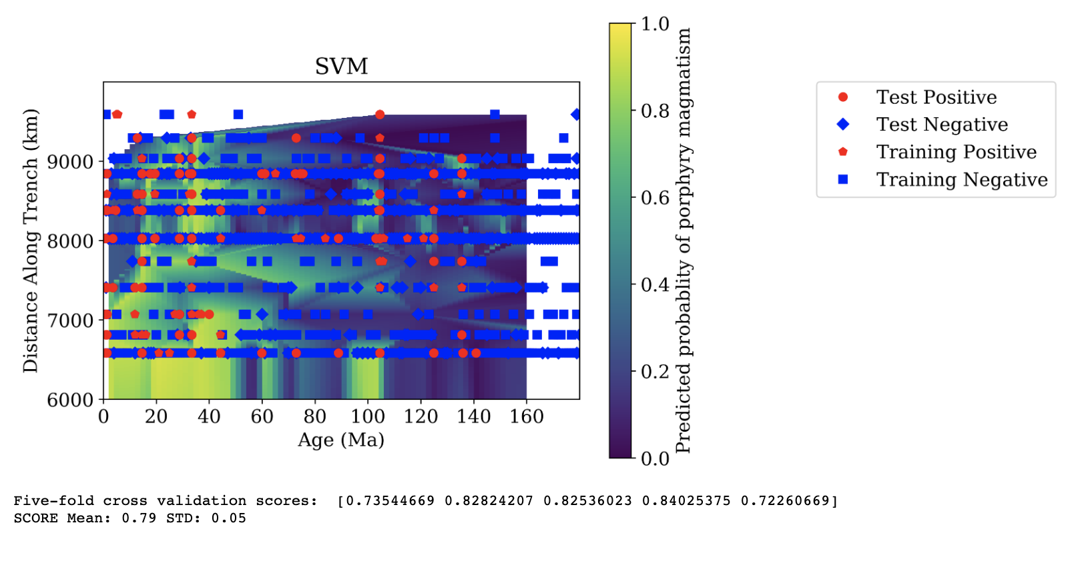
Support Vector Machine testing and training system

Slide 22
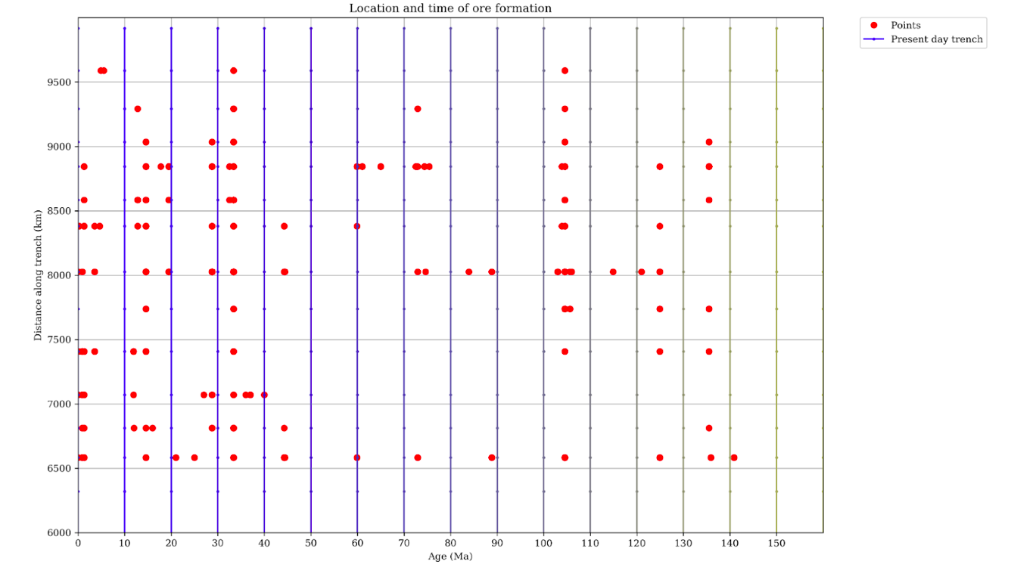
Limitations of dataset

Slide 23
Conclusion
The analysis of geo temporal and geospatial relationship between gold deposits and tectonic processes along western U.S.A. proved to be challenging due to the robust nature of the provided data.
The predicted results do show a shift in deposit data related to the tectonic event that occurred in the last 30 Million years.
The creation of the transform boundary that ceased all subduction near the western coast of U.S.A
The impact of the cordillera system did not seem to have as big of an affect as the San Andreas fault, which seems suspicious and could be due to the nature of data provided.

